Slide 1
BottleNet++: An End-to-End Approach for Feature Compression in Device-Edge Co-Inference Systems
J. Shao and J. Zhang, "BottleNet++: An End-to-End Approach for Feature Compression in Device-Edge Co-Inference Systems," 2020 IEEE International Conference on Communications Workshops (ICC Workshops), 2020, pp. 1-6. (cited by 50)
Advisor: Dr. Chih-Yu Wang
Presenter: Shao-Heng Chen
Date: April 06, 2022
Notes:
2020年6月發表於 IEEE ICC workshop 會議的論文

Slide 2
Outline
1. Overview
2. BottleNet++ architecture
3. Network components and training strategy
4. Evaluations
5. Conclusions and future works
1

Slide 3
Overview
1. Challenges for co-inference?
– Network splitting, and feature compression
2. Why BottleNet++?
– Feature compression and transmission vs. Feature coding
– Fault-tolerance property and JSCC [1] vs. Source coding
3. How to model the wireless channel?
– As a non-trainable layer [2]
[1] K. Choi, K. Tatwawadi, A. Grover, T. Weissman and S. Ermon, "Neural joint source-channel coding", International Conference on Machine Learning, pp. 1182-1192, 2019. (cited by 44)
[2] E. Bourtsoulatze, D. B. Kurka and D. Gündüz, "Deep joint sourcechannel coding for wireless image transmission", IEEE Transactions on Cognitive Communications and Networking, 2019. (cited by 150)
2
Notes:
1.co-inference的挑戰 Network splitting以減少算力需求, Feature compression以減少通訊成本 之前有報過一些常見方法
先前的常見方法是採取 feature coding method 有像是 JPEG, Huffman coding, BottleNet itself. 但這些都是 source coding only 的方法 目標是losses compression 且需要良好的通訊狀況 (reliable comm.)
也有人用JSCC 像是2019年ICML 有一篇是 透過seq-to-seq learning framework 在BEC傳text msg

Slide 4
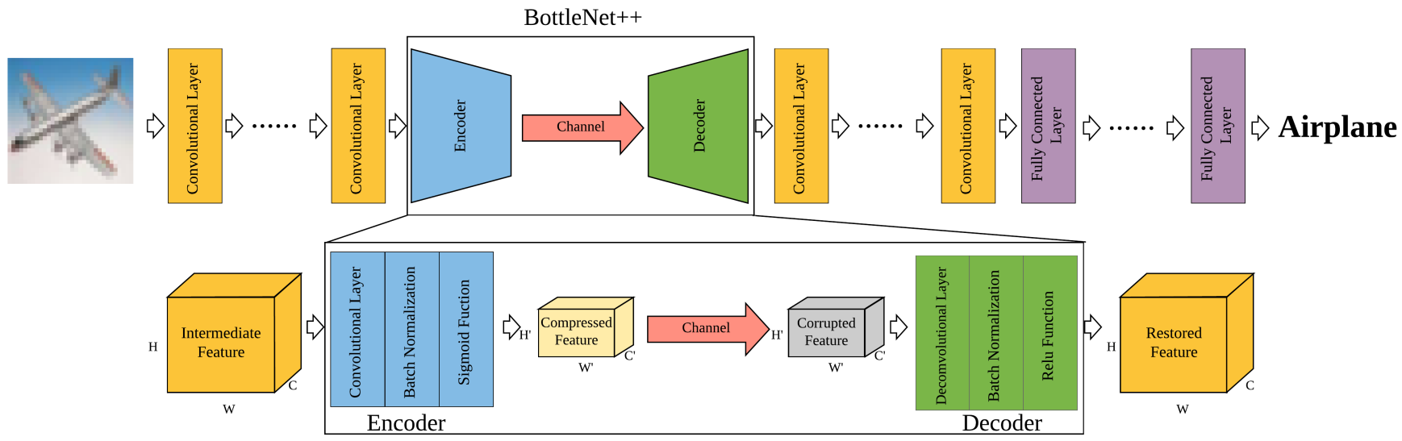
BottleNet++ Architecture
– End-to-end architecture
– Encoder + Channel model + Decoder
3
Notes:
For different channel model, just replace the transfer function

Slide 5

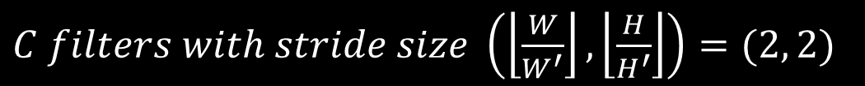
Encoder
– Feature Compression, Joint Source-Channel Coding (JSCC)
– Compress C channels to C’ channels
A conv. layer
(2) A batch normalization layer
(3) A Sigmoid activation layer
$feature tensor \left(channel, width, height\right) size=\left(C,W, H\right)$
$$kernel size=2×2$$
$C filters with stride size \left(\left\lfloor \frac{W}{W^{′}}\right\rfloor ,\left\lfloor \frac{H}{H^{′}}\right\rfloor \right)=(2, 2)$
4

Slide 6
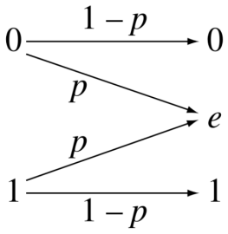
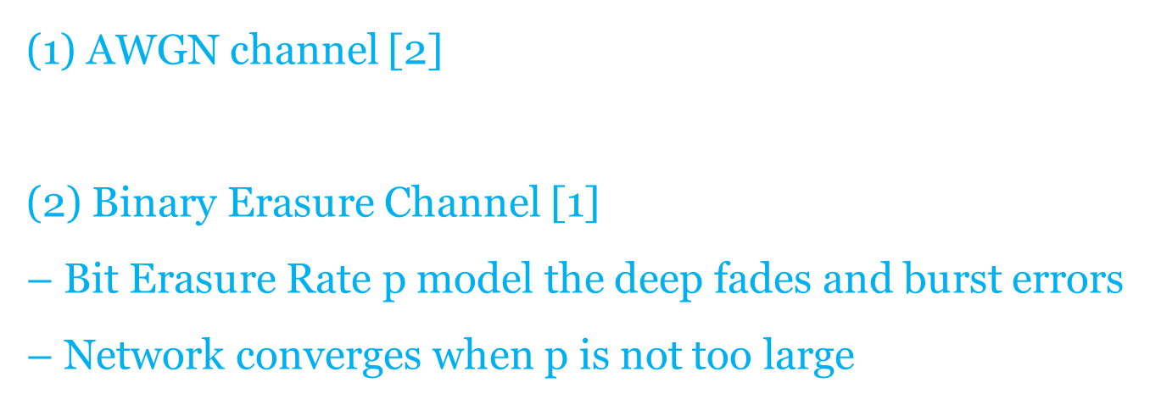
Channel Model
(1) AWGN channel [2]
$− f\left(x\right)=x+n, n\sim N(0, σ^{2})$
(2) Binary Erasure Channel [1]
– Bit Erasure Rate p model the deep fades and burst errors
– Network converges when p is not too large
$− quantizer \tilde{X}=round\left(X∙\left(2^{n}−1\right)\right) /$ $\left(2^{n}−1\right)$
[1] K. Choi, K. Tatwawadi, A. Grover, T. Weissman and S. Ermon, "Neural joint source-channel coding", International Conference on Machine Learning, pp. 1182-1192, 2019. (cited by 44)
[2] E. Bourtsoulatze, D. B. Kurka and D. Gündüz, "Deep joint sourcechannel coding for wireless image transmission", IEEE Transactions on Cognitive Communications and Networking, 2019. (cited by 150)
5
Notes:
BEC 二元輸入 三元輸出 模擬deep fade跟burst error
能不能做到end-to-end training 要看channel的transfer function能不能微 像是AWGN的可微 但BEC的不可微 所以在BP的時候直接忽略BEC channel model

Slide 7
Decoder
– Restore the bitstream to feature tensor
– Recover C’ channels to C channels
A deconv. layer
(2) A batch normalization layer
(3) A ReLU activation layer
$feature tensor \left(channel, width, height\right) size=\left(C^{′}, W^{′}, H^{′}\right)$
$$kernel size=2×2$$
$C filters with stride size \left(\left\lfloor \frac{W}{W^{′}}\right\rfloor ,\left\lfloor \frac{H}{H^{′}}\right\rfloor \right)=(2, 2)$
6

Slide 8
Training Strategy
– Direct training may cause slow convergence
(1) Train the DNN
(2) Train the encoder/decoder
(3) Fine-tuning whole network
– Model the wireless channel as a n0n-trainable layer [3]
– Only need to retrain the JSCC module for different channel conditions
[3] A. E. Eshratifar, A. Esmaili and M. Pedram, "BottleNet: A Deep Learning Architecture for Intelligent Mobile Cloud Computing Services," 2019 IEEE/ACM International Symposium on Low Power Electronics and Design (ISLPED), 2019, pp. 1-6 (cited by 58)
7
Notes:
1.只train DNN
2.只train encoder/decoder
3.fine-tuning

Slide 9
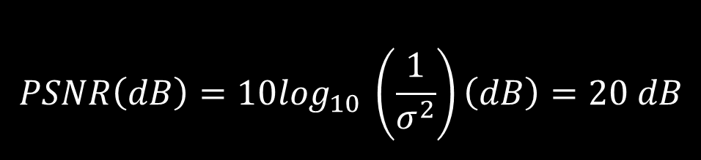
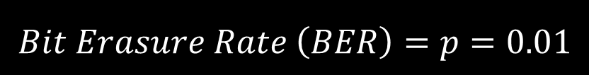
Experimental settings
– Image classification on CIFAR-100, 100 class of 60000 32 x 32 color images
– Main branch: VGG16, ResNet50
– AWGN channel with
– BEC with
– Note.
(1) Not all layers can be use as a splitting point
(2) FC layer, Conv. layer can be regarded as one
$$PSNR\left(dB\right)=10\log_{10} \left(\frac{1}{σ^{2}}\right)\left(dB\right)=20 dB$$
$$Bit Erasure Rate \left(BER\right)=p=0.01$$
8

Slide 10
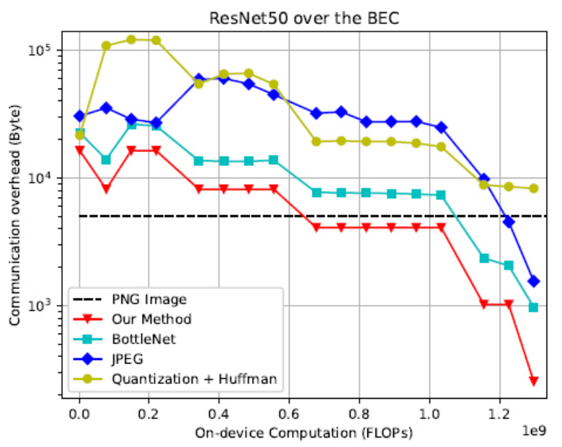
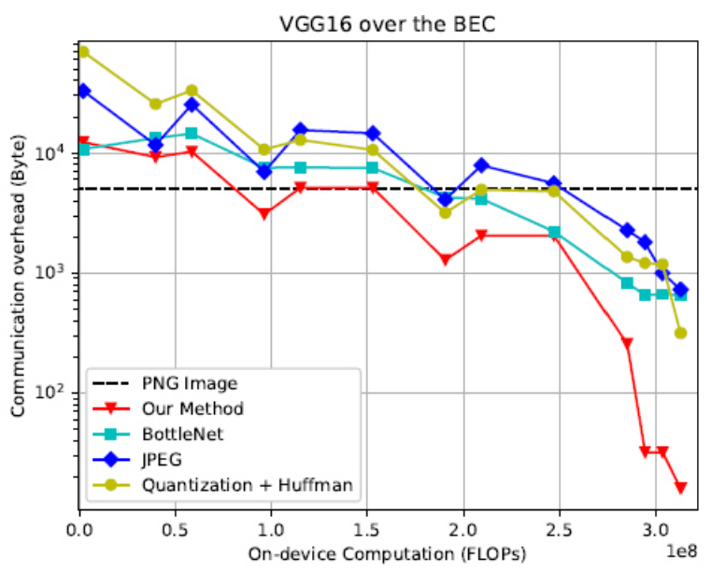
Experimental results
– On-device Computational vs. Communication Overhead in BEC
$Fig. 2.On−device Computation vs. Communication Overhead in BEC with \left(a\right) ResNet50 and (b) VGG16$
9
Notes:
Data rate固定

Slide 11
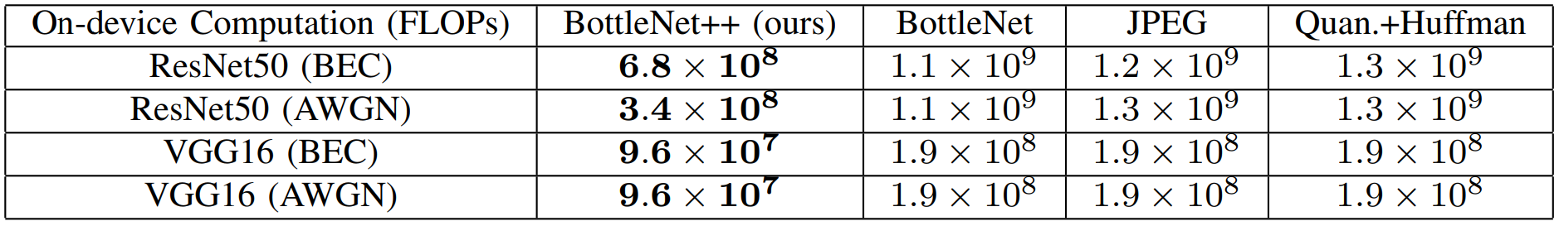
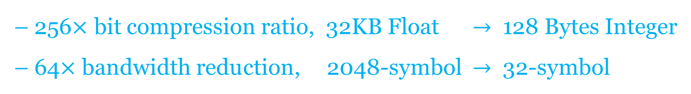
Experimental results
– Minimum On-device Comp. with Comm. Overhead less than raw data
– 256$×$ bit compression ratio, 32KB Float $→$ 128 Bytes Integer
– 64$×$ bandwidth reduction, 2048-symbol $→$ 32-symbol
10

Slide 12
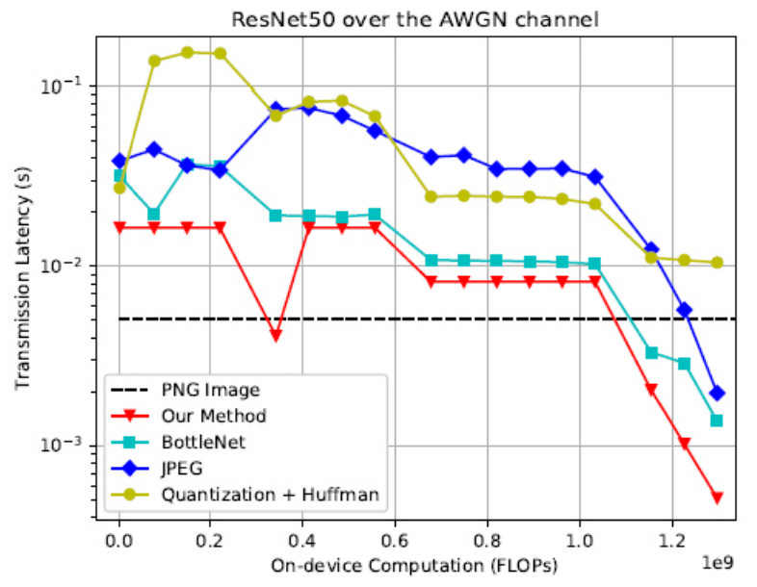
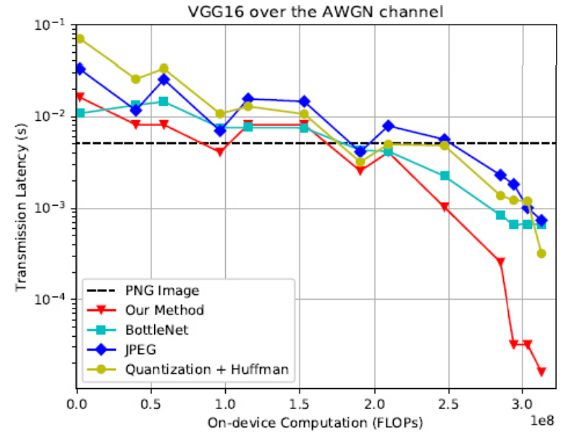
Experimental results
– On-device Computational vs. Transmission Latency in AWGN channel
$Fig. 2.On−device Computation vs. Transmission Latency in BEC with \left(c\right) ResNet50 and (d) VGG16$
11

Slide 13
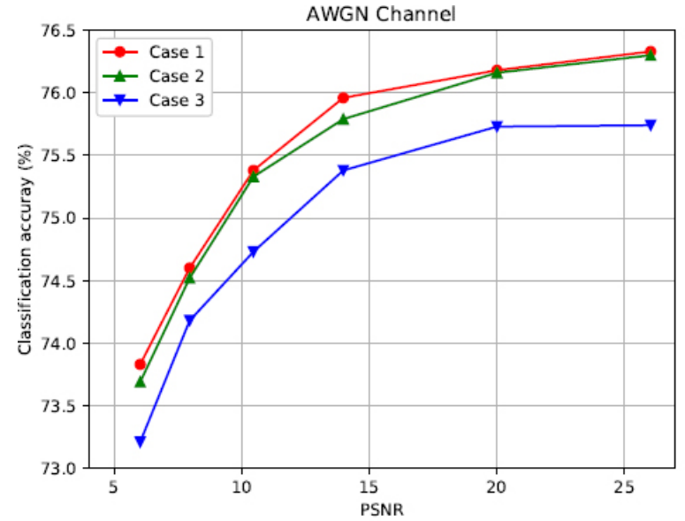
Experimental results
– Accuracy degradation for testing generalization ability
– CSI (BER, PSNR) known or unknown
 | training | testing
Case 1 | O | O
Case 2 | O | X
Case 3 | X | X
$Fig. 3. Accuracy degradation over the \left(a\right) AWGN channel$
12
Notes:
在AWGN channel 若PSNR 從25dB掉到10dB accuracy 掉不到 1%

Slide 14
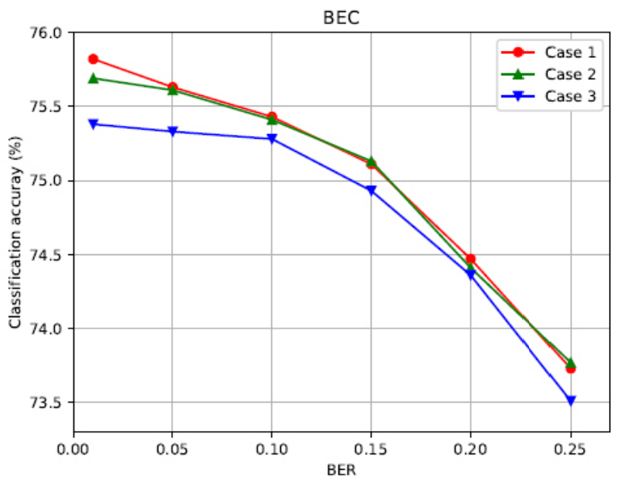
Experimental results
– Accuracy degradation for testing generalization ability
– CSI (BER, PSNR) known or unknown
 | training | testing
Case 1 | O | O
Case 2 | O | X
Case 3 | X | X
$Fig. 3. Accuracy degradation over the \left(b\right) BEC$
13
Notes:
在BEC 若BER 從0.01上升到0.15 一樣accuracy 掉不到 1%

Slide 15
Conclusions and Future Works
– Useful insights
(1) Model the wireless channel as a non-trainable seems reasonable
(2) Not all layers can be use as a splitting point
– Ideas
(1) Maybe first test on DL_CFAR, before jump into YOLO_CFAR
(2) Is there any information leakage from the encoder output?
– Problems
(1) How to actually model a wireless channel as a non-trainable layer
(2) Need to figure out the reasonable settings for CFAR case
14

